Slide 1
Reinforcement Learning
Md. Golam Rabiul Alam
Associate Professor, Department of Computer Engineering
BRAC University

Slide 2
Presentation Outline
Introduction
RL Basics
An Example of RL
Conclusion

Slide 3
Introduction
Supervised Learning: Immediate feedback (labels provided for every input).
(classification and regression)
Unsupervised Learning: No feedback (no labels provided).
(clustering, dimensionality reduction)
Reinforcement Learning: Delayed scalar feedback (a number called reward).
(Autonomic management and control)
RL deals with agents that must sense & act upon their environment.
This combines classical AI and machine learning techniques.
Examples:
Robot-soccer
How to invest in shares
Modeling the economy through rational agents
Learning how to fly a helicopter
https://www.youtube.com/watch?v=VCdxqn0fcnE
AlphaGo: https://www.youtube.com/watch?v=-D3MyAm3JFo

Slide 4
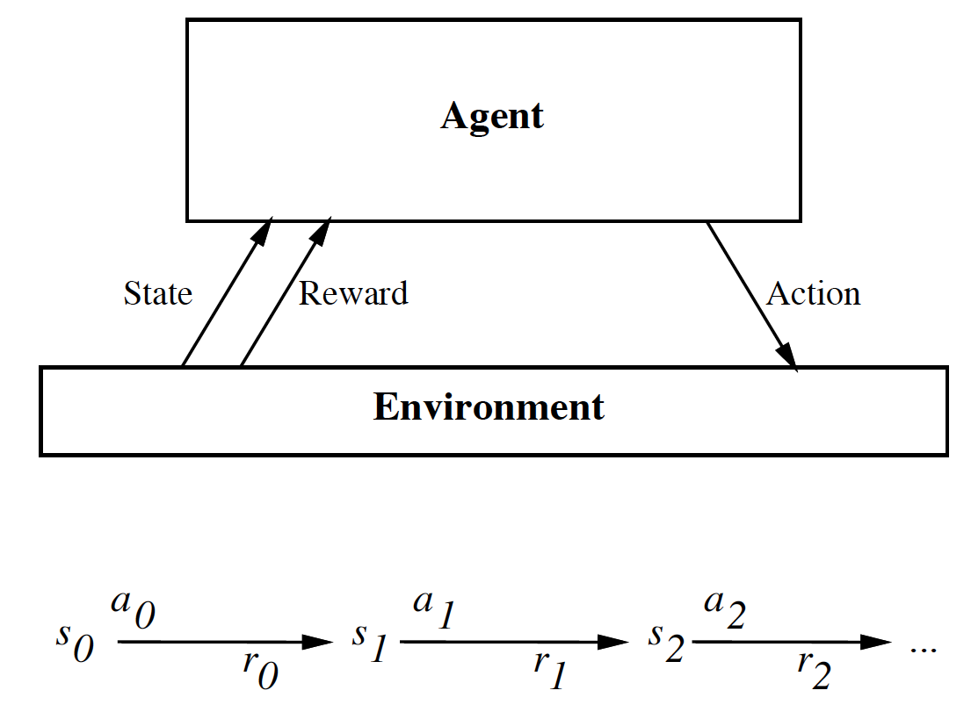
The Big Picture
Your action influences the state of the world which determines its reward

Slide 5
Complications
The outcome of your actions may be uncertain
You may not be able to perfectly sense the state of the world
The reward may be stochastic.
Reward is delayed (i.e. finding food in a maze)
You may have no clue (model) about how the world responds to your actions.
You may have no clue (model) of how rewards are being paid off.
The world may change while you try to learn it
How much time do you need to explore uncharted territory before you
exploit (what you have learned)?

Slide 6
Markov Decision Process
A Markov decision process (MDP) is a discrete time
stochastic control process.
It provides a mathematical framework for modeling
decision making in situations where outcomes are
partly random and partly under the control of a
decision maker.
MDPs are useful for studying optimization problems
solved via dynamic programming and reinforcement
learning.

Slide 7
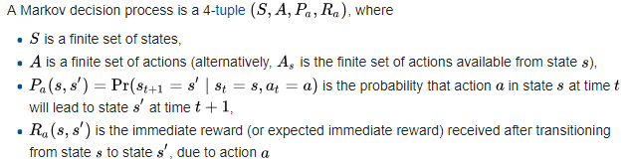
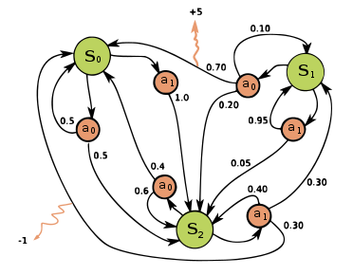
MDP

Slide 8
The Objective
To learn an optimal policy that maps states of the world to actions of the agent.
I.e., if this patch of room is dirty, I clean it. If my battery is empty, I recharge it.
What is it that the agent tries to optimize?
Answer: the total future discounted reward:
Note: immediate reward is worth more than future reward.

Slide 9
Policy from Value Function
Let’s say we have access to the optimal value function that computes the
total future discounted reward
What would be the optimal policy ?
Answer: we choose the action that maximizes:
We assume that we know what the reward will be if we perform action “a” in
state “s”:
We also assume we know what the next state of the world will be if we perform
action “a” in state “s”:

Slide 10
Q-Function
One approach to RL is to try to estimate V*(s).
However, this approach requires you to know r(s,a) and delta(s,a).
This is unrealistic in many real problems. What is the reward if a robot
is exploring mars and decides to take a right turn?
Fortunately we can circumvent this problem by exploring and experiencing
how the world reacts to our actions. We need to learn r & delta.
We want a function that directly learns good state-action pairs, i.e.
what action should I take in this state. We call this Q(s,a).
Given Q(s,a) it is now trivial to execute the optimal policy, without knowing
r(s,a) and delta(s,a). We have:
Bellman Equation:

Slide 11
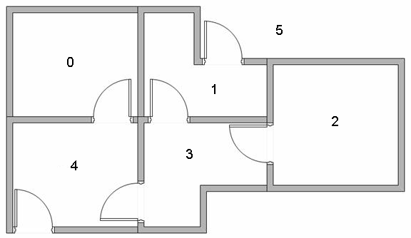
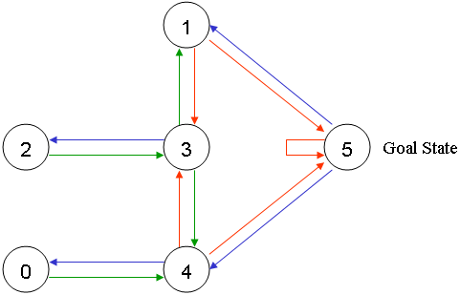
Path Finding using RL

Slide 12
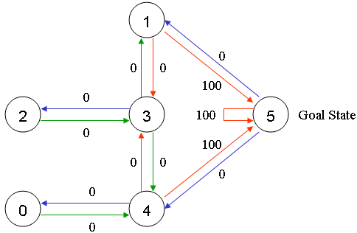
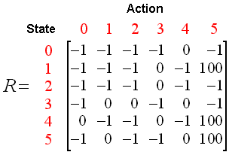
Path Finding using RL

Slide 13
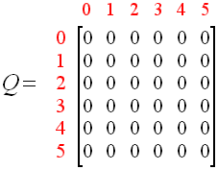


Path Finding using RL (Learning stage)
$$Q=\left[\begin{matrix}0 & 0 & 0 \\ 0 & 0 & 0 \\ \begin{aligned}0 \\ 0 \\ 0 \\ 0\end{aligned} & \begin{aligned}0 \\ 0 \\ 0 \\ 0\end{aligned} & \begin{aligned}0 \\ 0 \\ 0 \\ 0 \end{aligned}\end{matrix}\begin{matrix}0 & 0 & 0 \\ 0 & 0 & 100 \\ \begin{aligned}0 \\ 0 \\ 0 \\ 0\end{aligned} & \begin{aligned}0 \\ 0 \\ 0 \\ 0\end{aligned} & \begin{aligned}0 \\ 0 \\ 0 \\ 0\end{aligned}\end{matrix}\right]$$
Q(state, action) = R(state, action) + Gamma * Max[Q(next state, all actions)]
Q(1, 5) = R(1, 5) + 0.8 * Max[Q(5, 1), Q(5, 4), Q(5, 5)] = 100 + 0.8 * 0 =100
$$Q=\left[\begin{matrix}0 & 0 & 0 \\ 0 & 0 & 0 \\ \begin{aligned}0 \\ 0 \\ 0 \\ 0\end{aligned} & \begin{aligned}0 \\ 80 \\ 0 \\ 0\end{aligned} & \begin{aligned}0 \\ 0 \\ 0 \\ 0 \end{aligned}\end{matrix}\begin{matrix}0 & 0 & 0 \\ 0 & 0 & 100 \\ \begin{aligned}0 \\ 0 \\ 0 \\ 0\end{aligned} & \begin{aligned}0 \\ 0 \\ 0 \\ 0\end{aligned} & \begin{aligned}0 \\ 0 \\ 0 \\ 0\end{aligned}\end{matrix}\right]$$
Q(3, 1) = R(3, 1) + 0.8 * Max[Q(1, 3),Q(1, 5)] = 0 + 0.8 * 100 =80

Slide 14
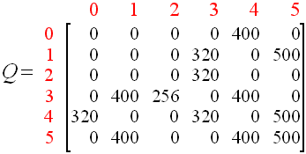
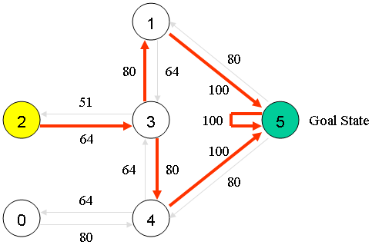
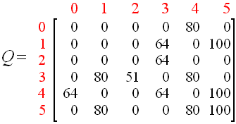
Path Finding using RL (Testing Stage)

Slide 15
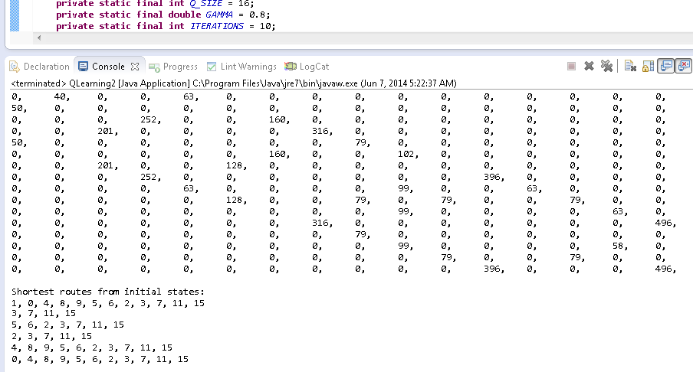
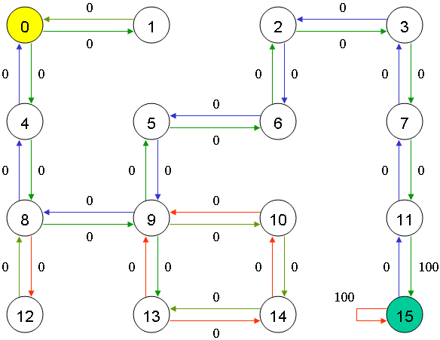
Path Finding using RL (Contd.)

Slide 16
Variations and Extensions
Monte Carlo (MC)
Temporal difference learning (TD)
Q-learning (off policy)
SARSA (On policy)
To deal with stochastic environments, we need to maximize expected future discounted reward:
Often the state space is too large to deal with all states. In this case we need to learn a function

Slide 17
Conclusion
Reinforcement learning
use when need to make decisions in uncertain environment
actions have delayed effect
Solution methods
dynamic programming
need complete model
If you don’t have complete model( simple algorithms)
Monte Carlo
time difference learning
Sarsa, Q-learning
Most works
designing features, state representation, rewards

Slide 18
IF You Have Any Question?

Slide 19
THANK YOU

